Slide 1
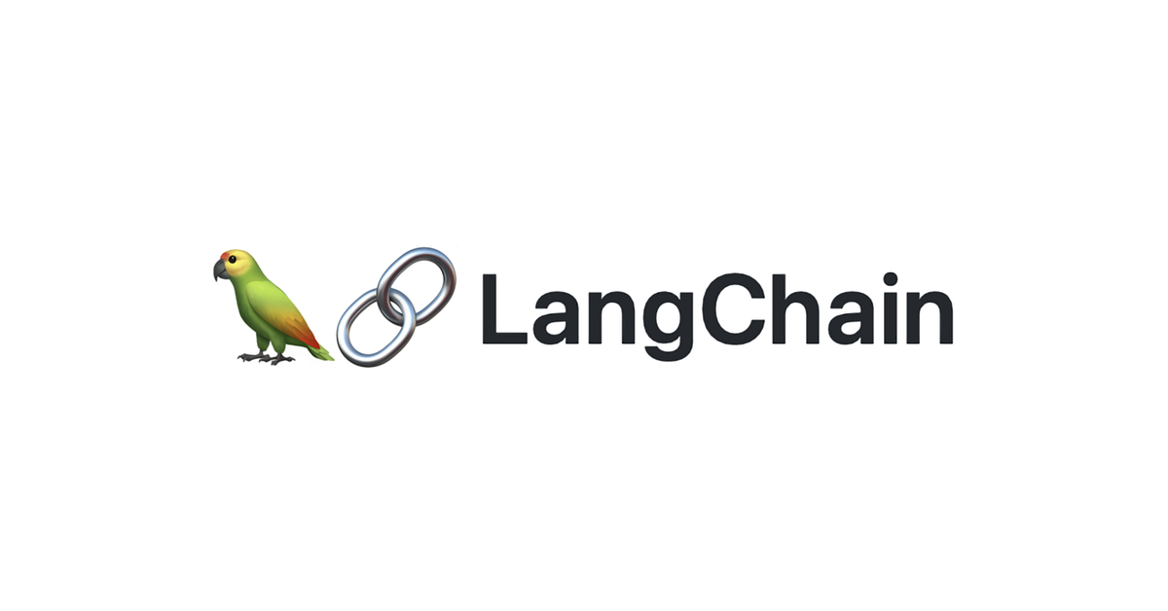
RAG from scratch: Retrieval
Lance Martin
Software Engineer, LangChain
@RLanceMartin
Notes:
This is the third video in our series on RAG. The aim of this series is to build up an understanding of RAG from scratch, starting with the basics of indexing, retrieval, and generation. This video focuses on retrieval, covering the process of document search using an index. See this notebook for code: https://github.com/langchain-ai/rag-from-scratch/blob/main/rag_from_scratch_1_to_4.ipynb

Slide 2
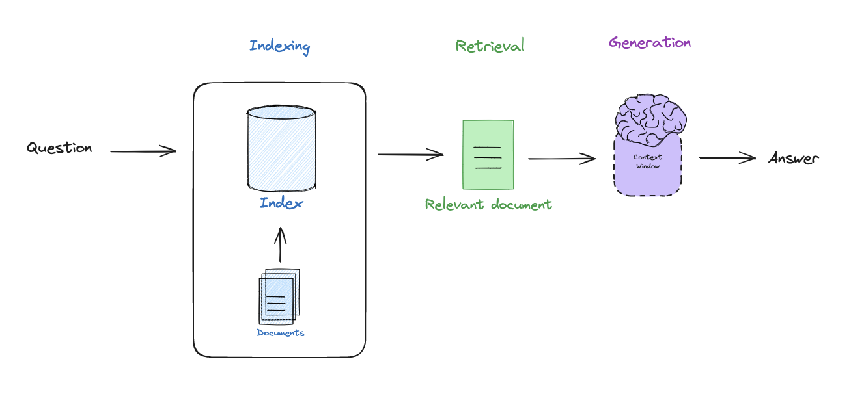
RAG motivation
Notes:
In the first video, we walked through the basic components of RAG: (1) indexing (make external data retrievable), (2) retrieval (fetch external data that is relevant to a query that we want the LLM to reason about, (3) generation pass this to an LLM to generate an answer. And in the last video we discussed indexing. Here we’ll talk about retrieval.

Slide 3
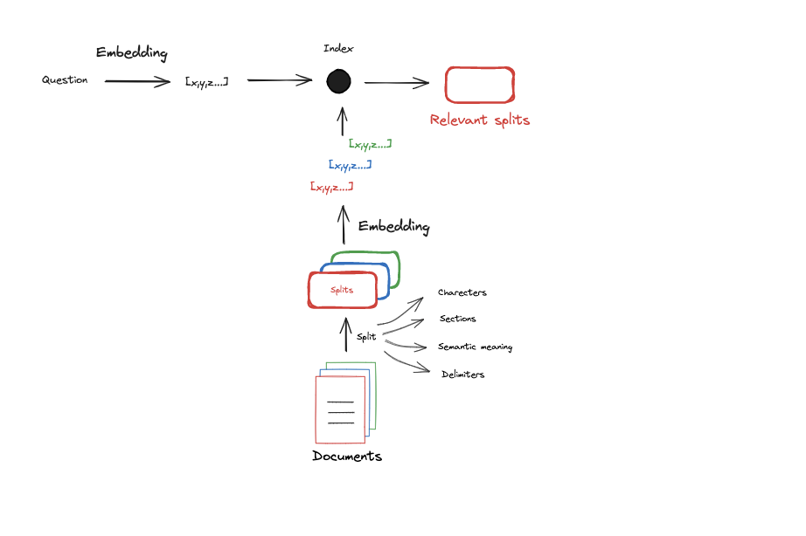
Index makes documents easy to retrieve
Notes:
With this in mind, indexing is the process of taking documents and mapping them to a representation that is easily searchable. For many LLM applications, embedding models have been used. And because LLMs and embedding models have a limited context window, often documents are split up before they are embedded.

Slide 4
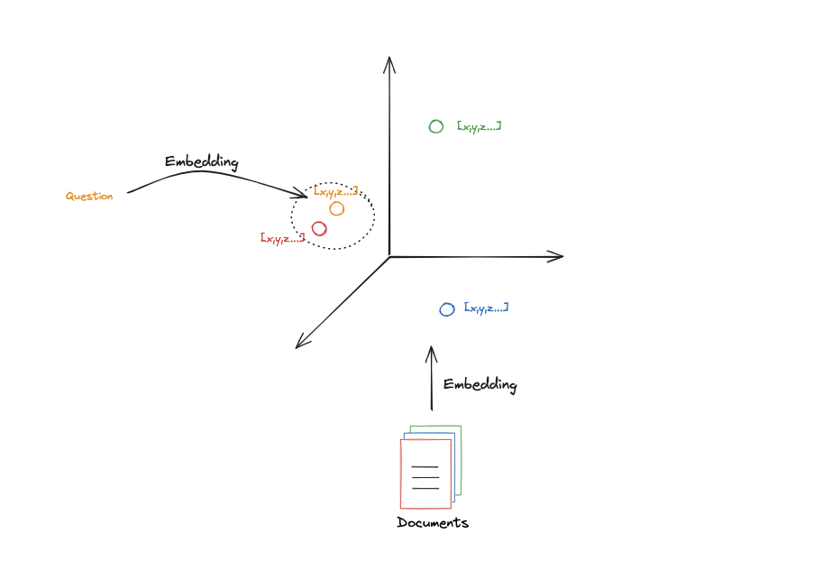
Retrieval powered via similarity search
https://simonwillison.net/2023/Oct/23/embeddings/
Notes:
We’ve taken documents and compressed them into a vector. Let’s assume the vector only had 3 values. We could then view them in 3D space. The location in space represents the semantic meaning of the content.
The central intuition is that documents with similar semantic meaning will be close to each other in this space.
So, if we hve a question and we want to find documents that are similar, we can look for it’s neighbors in this space.
Of course, the actual embedding space has many more dimensions than this. But this gives you the key idea.

Slide 5
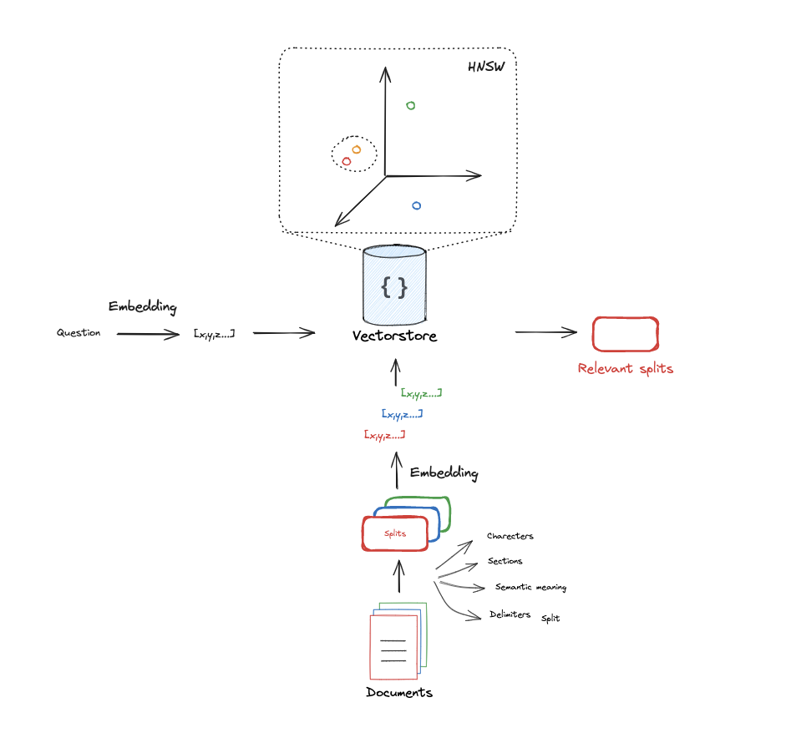
Vectorstores implement this for you
https://www.pinecone.io/learn/series/faiss/hnsw/
Notes:
Vectorstores implement this search for us using different approaches, but the inition is a high dimensional search for nearby (or similar) documents to our query.

Slide 6
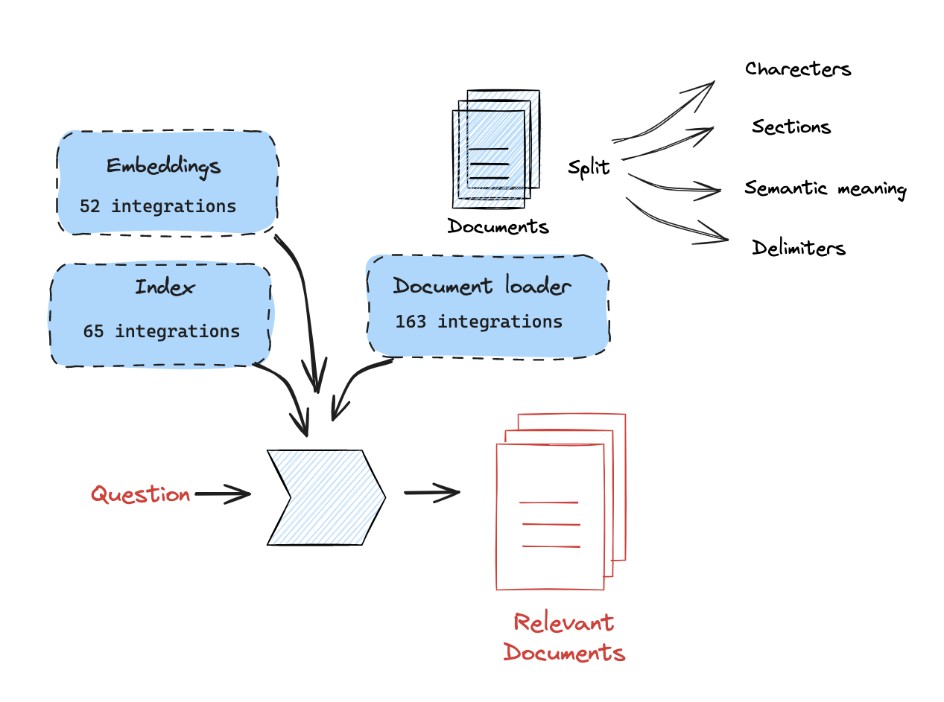
LangChain has many integrations to support this
https://integrations.langchain.com/
https://vdbs.superlinked.com/

Slide 7
Code walk-through

